Slide 1
Social Media, Misogyny and Labor Outcomes
Final Presentation
Qiuyu (Jora) Li

Slide 2



Misogyny & Gender Wage Gap (Becker, 1957)
A gender wage gap
Men get more pay than equally skilled women
Men are more scarce
Hiring more men
Distaste of women

Slide 3



Table of Content
Twitter Misogyny Index
Observational results
Conclusions
Cross-state and cross-county patterns
A gender wage gap

Slide 4
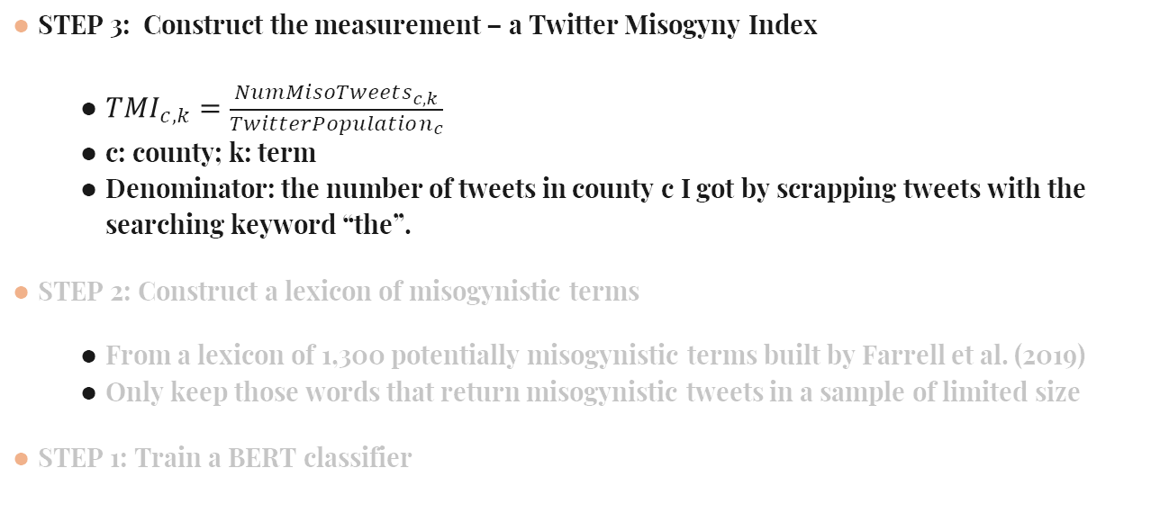
The Measurement of Misogyny
STEP 3: Construct the measurement – a Twitter Misogyny Index
${TMI}_{c,k}=\frac{NumMisoTweets_{c,k}}{TwitterPopulation_{c}}$
c: county; k: term
Denominator: the number of tweets in county c I got by scrapping tweets with the searching keyword “the”.
STEP 2: Construct a lexicon of misogynistic terms
From a lexicon of 1,300 potentially misogynistic terms built by Farrell et al. (2019)
Only keep those words that return misogynistic tweets in a sample of limited size
STEP 1: Train a BERT classifier

Slide 5
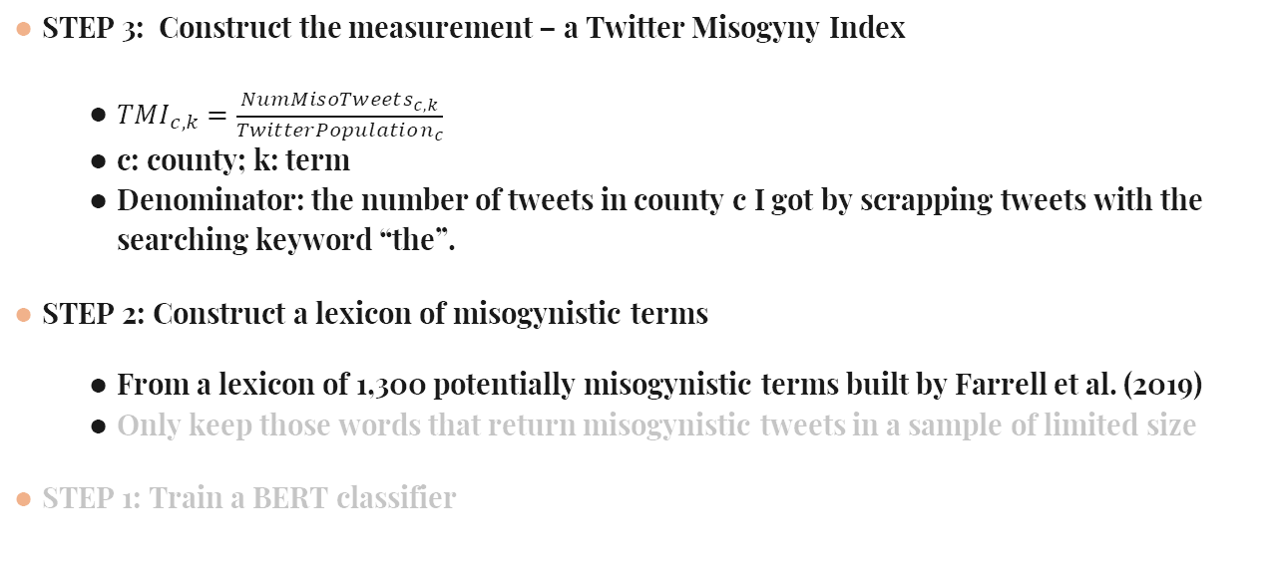
The Measurement of Misogyny
STEP 3: Construct the measurement – a Twitter Misogyny Index
${TMI}_{c,k}=\frac{NumMisoTweets_{c,k}}{TwitterPopulation_{c}}$
c: county; k: term
Denominator: the number of tweets in county c I got by scrapping tweets with the searching keyword “the”.
STEP 2: Construct a lexicon of misogynistic terms
From a lexicon of 1,300 potentially misogynistic terms built by Farrell et al. (2019)
Only keep those words that return misogynistic tweets in a sample of limited size
STEP 1: Train a BERT classifier

Slide 6
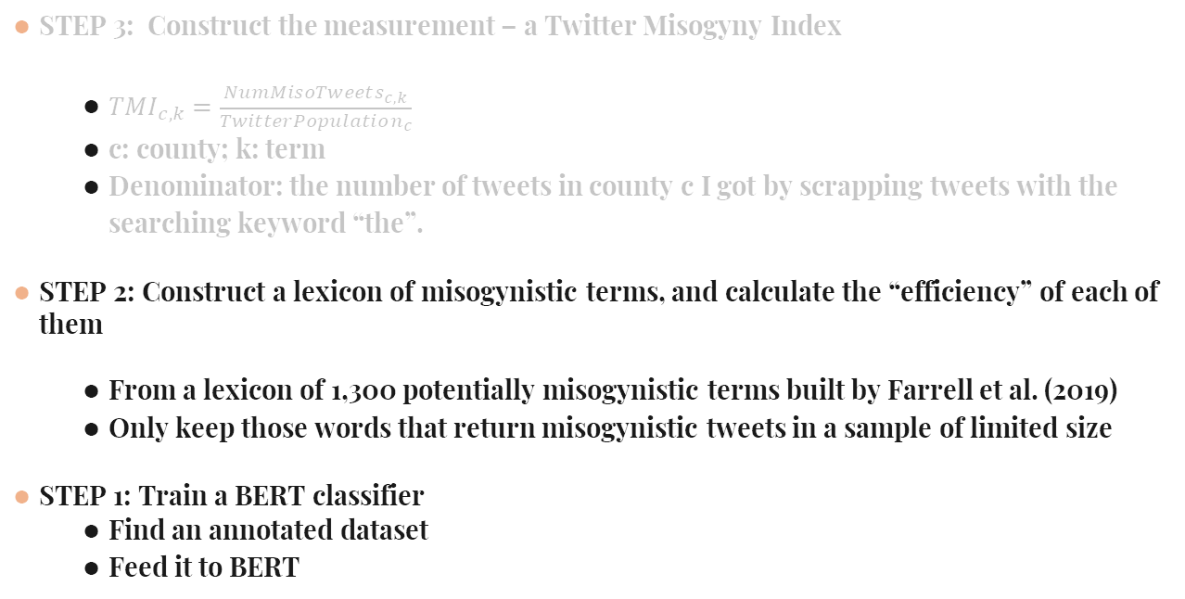
The Measurement of Misogyny
STEP 3: Construct the measurement – a Twitter Misogyny Index
${TMI}_{c,k}=\frac{NumMisoTweets_{c,k}}{TwitterPopulation_{c}}$
c: county; k: term
Denominator: the number of tweets in county c I got by scrapping tweets with the searching keyword “the”.
STEP 2: Construct a lexicon of misogynistic terms, and calculate the “efficiency” of each of them
From a lexicon of 1,300 potentially misogynistic terms built by Farrell et al. (2019)
Only keep those words that return misogynistic tweets in a sample of limited size
STEP 1: Train a BERT classifier
Find an annotated dataset
Feed it to BERT

Slide 7
The process: Train the classifer
01
02
Guest et al. (2021): the annotated dataset for training
“bert-base-uncased”
From Reddit.
5,868 nonmisogynistic posts v.s. 699 misogynistic posts
Accuracy score on the test set: 0.9

Slide 8
The process
01
03
Guest et al. (2021): the annotated dataset for training
“bert-base-uncased”
Primary tweets collection
04
05
06
Misoginistic terms
Second round of tweets collection
Identify user location
02
From Reddit.
5,868 nonmisogynistic posts v.s. 699 misogynistic posts
Accuracy score on the test set: 0.9
Five random dates in 2021: 02/26, 05/10，07/22, 10/03, and 12/15.
In total: 3,894,780
16 terms, “bitch” most frequently
10 random dates in 2021.
In total: 1,516,565
Number of tweets with state tags: 315,151
Number of tweets with county tags: 90,598

Slide 9
The process
01
02
03
Guest et al. (2021): the annotated dataset for training
“bert-base-uncased”
Primary tweets collection
04
05
06
Misoginistic terms
Second round of tweets collection
Identify user location
From Reddit.
5,868 nonmisogynistic posts v.s. 699 misogynistic posts
Accuracy score on the test set: 0.9
Five random dates in 2021: 02/26, 05/10，07/22, 10/03, and 12/15.
In total: 3,894,780
16 terms, “bitch” most frequently
10 random dates in 2021.
In total: 1,516,565
Number of tweets with state tags: 315,151
Number of tweets with county tags: 90,598

Slide 10
The process
01
02
03
Guest et al. (2021): the annotated dataset for training
“bert-base-uncased”
Primary tweets collection
04
05
06
Misoginistic terms
Second round of tweets collection
Identify user location
From Reddit.
5,868 nonmisogynistic posts v.s. 699 misogynistic posts
Accuracy score on the test set: 0.9
Five random dates in 2021: 02/26, 05/10，07/22, 10/03, and 12/15.
In total: 3,894,780
16 terms, “bitch” most frequently
10 random dates in 2021.
In total: 1,516,565
Number of tweets with state tags: 309,083
Number of tweets with county tags: 59,121

Slide 11
The process
01
02
03
Guest et al. (2021): the annotated dataset for training
“bert-base-uncased”
Primary tweets collection
04
05
06
Misoginistic terms
Second round of tweets collection
Identify user location
From Reddit.
5,868 nonmisogynistic posts v.s. 699 misogynistic posts
Accuracy score on the test set: 0.9
Five random dates in 2021: 02/26, 05/10，07/22, 10/03, and 12/15.
In total: 3,894,780
16 terms, “bitch” most frequently
10 random dates in 2021.
In total: 1,516,565
Number of tweets with county tags: 59,121
Number of tweets with state tags: 309,083

Slide 12
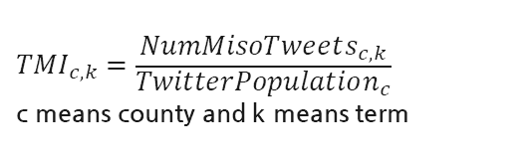
The process
07
08
Third round of tweets scrapping by searching for the word “the”
Calculating the Twitter Misogyny Index
06
Identify user location
Number of tweets with county tags: 59,121
Number of tweets with state tags: 309,083
On March 10
1,702,247 tweets were collected
$${TMI}_{c,k}=\frac{NumMisoTweets_{c,k}}{TwitterPopulation_{c}}$$
c means county and k means term

Slide 13
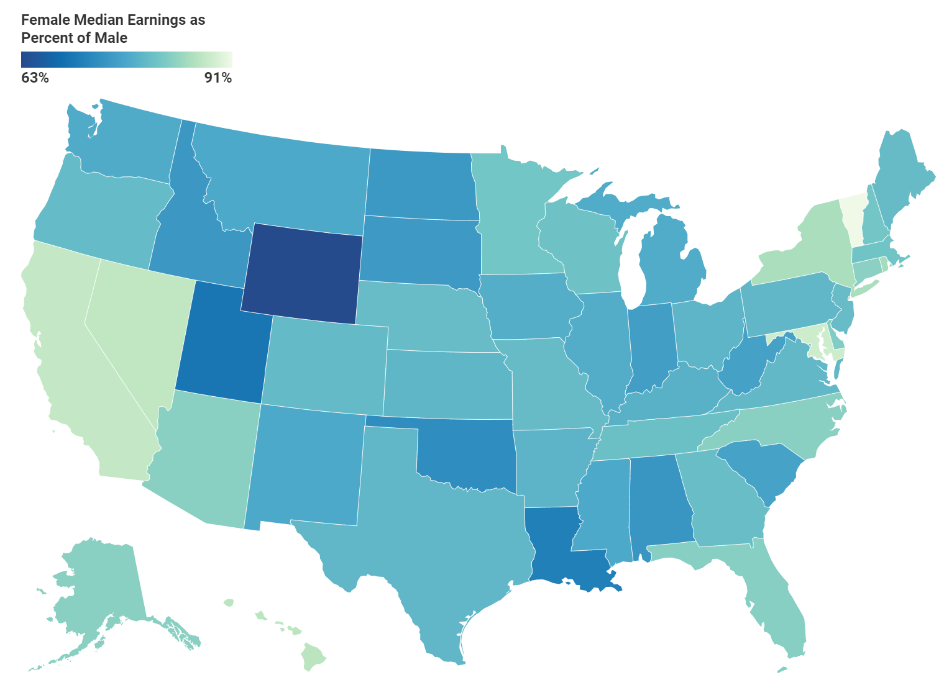
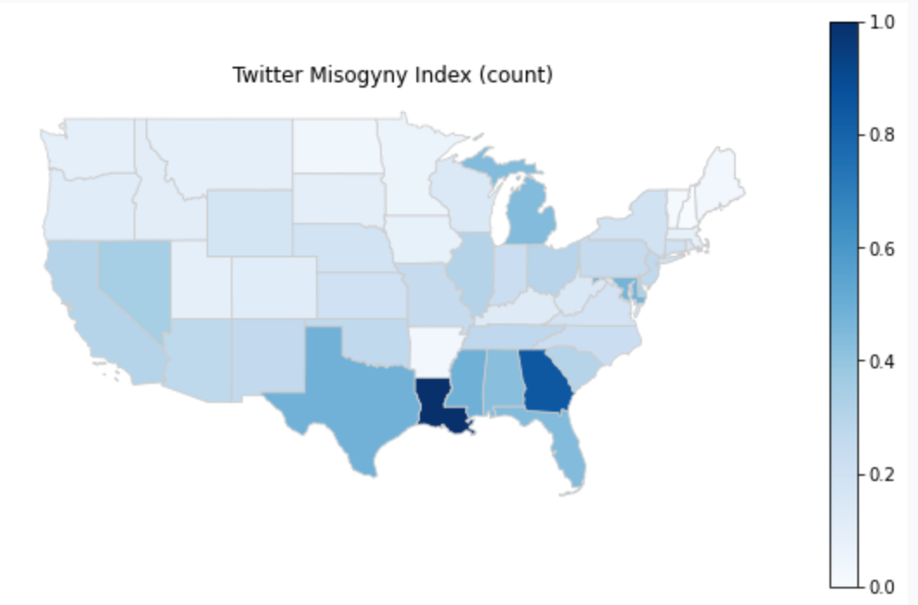
Primary results: state-level

Slide 14
Primary results: state-level -- INCONSISTENT!

Slide 15
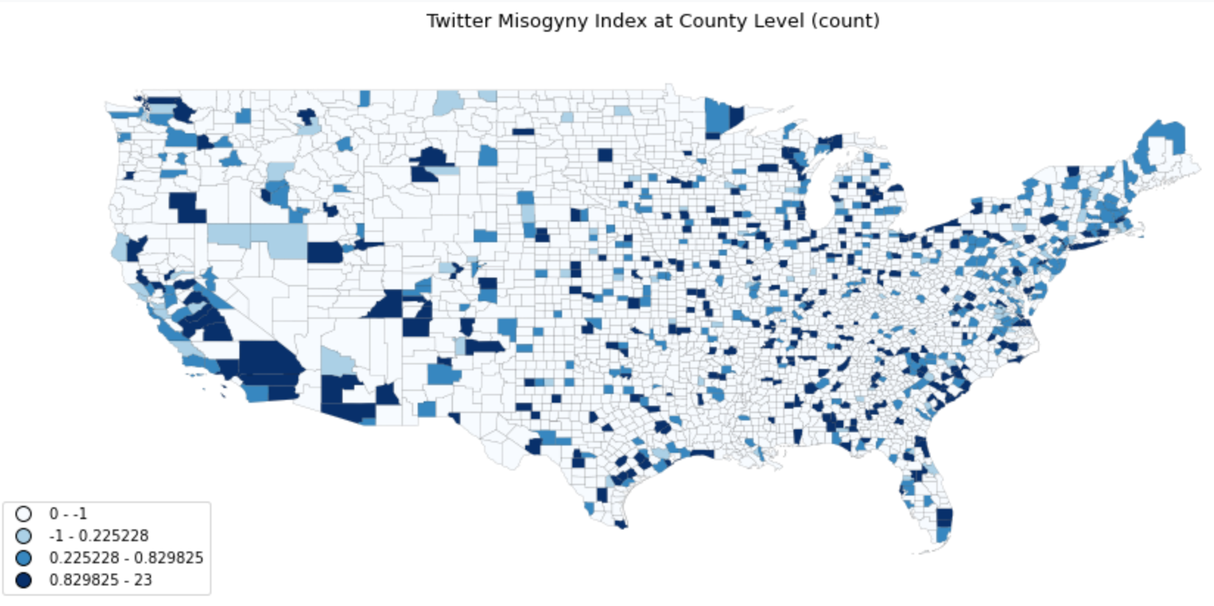
Primary results: county-level

Slide 16
Another Problem
Solution
Different terms in my lexicon are unequally efficient in returning misogynistic tweets
Calculate a coefficient matrix between the frequency of each of the terms and the labor outcomes

Slide 17

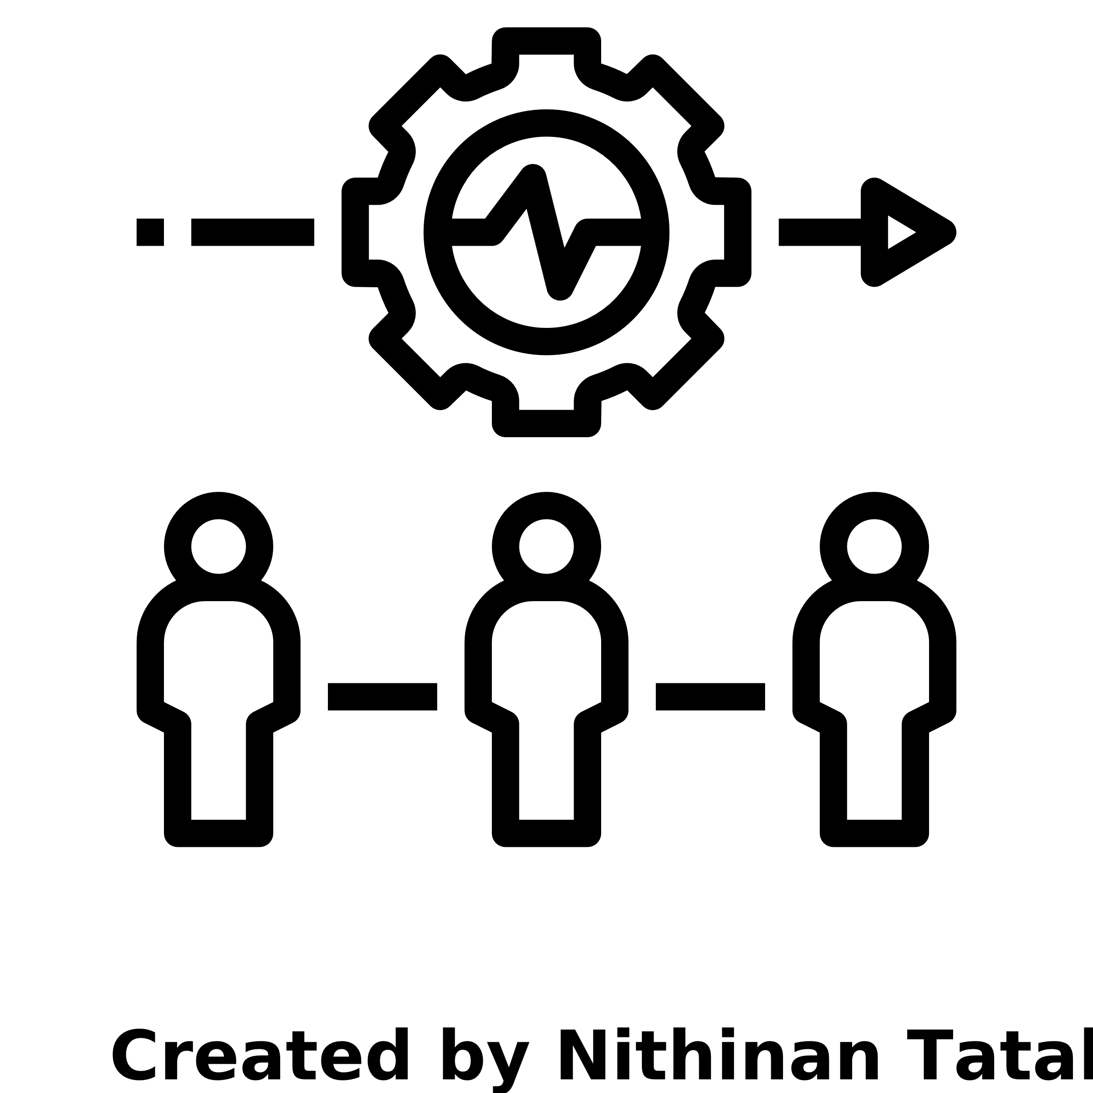

American Community Survey
Larbor market participation
Earnings
Education
Median wage of female workers / male workers
Median wage of female full-time workers / male workers
Average wage of female workers / male workers
Proportion of people high school degree or above among 25-or-above female / male
Proportion of people with Bachelor’s degree or above among 25-or-above female / male
Proportion of workers with earnings among female population / male population
Proportion of full-time workers among female population / male population

Slide 18
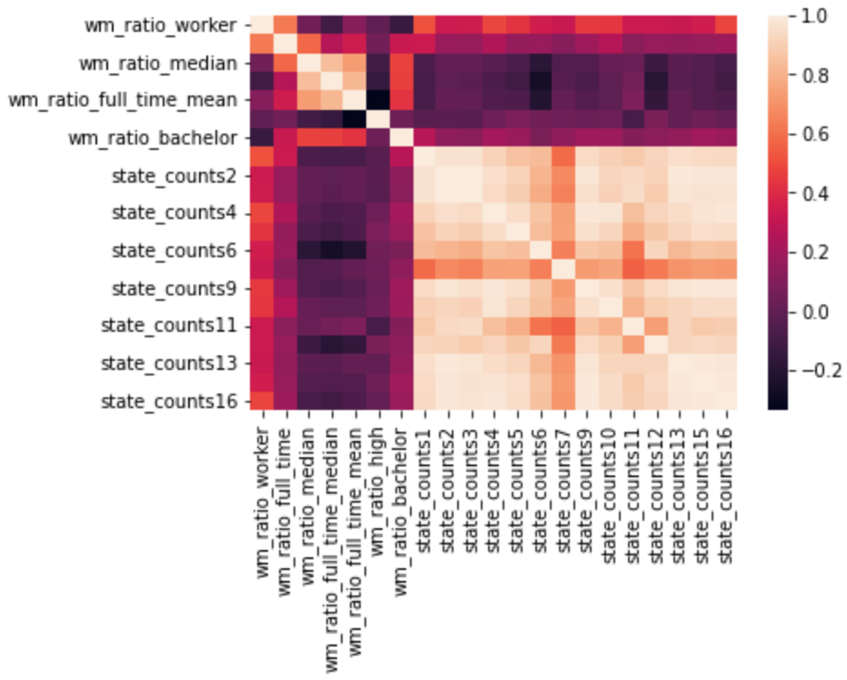
Heatmap of correlation matrix – state-level
Labor market participation
Earnings
Education
Frequency of different misogynistic terms
The occurrences of the terms are highly correlated

Slide 19
Heatmap of correlation matrix – state-level
Labor market participation
Earnings
Education
Frequency of different misogynistic terms
The occurrences of the terms are highly correlated
The occurrences of misogynistic terms seem to be correlated with measurements of labor market participation
But the correlation is small or even negative for other variables

Slide 20

1. Little evidence was found that supported Becker’s taste-based discrimination model 2. But…the results might be different if I got more county-level data

